Slide 1
Capstone Project
Airbnb Booking analysis By Bhavani Lalam

Slide 2
Introduction to Airbnb
Airbnb, Inc is an American company that operates an online marketplace for lodging, primarily homestays for vacation rentals, and tourism activities. Based on San Francisco, California, the platform is accessible via website and mobile app. Airbnb does not own any of the listed properties; instead, it profits by receiving commission from each booking. The company was founded in 2008 by Brain Chesky, Nathan Blecharczyk, and Joe Gebbia. Airbnb is a shortened version of its original name, AirBedandBreakfast.com.
The company is regulated by many jurisdictions, including the European Union and cities such as San Francisco and New York city.

Slide 3
Introduction to Exploratory Data Analysis
Exploratory Data Analysis is a process of examining or understanding the data and extracting insights or main characteristics of the data. EDA is generally classified into two methods, i.e. graphic and non-graphical analysis.
EDA is very essential because it is a good practice to first understand the problem statement and the various relationships between the data features before getting your hands dirty.
Technically, The primary motive of EDA is to:
Examine the data distribution
Handling missing values of the dataset
Handling the outliers
Removing duplicate data
Encoding the categorical variables
Normalizing and scaling

Slide 4
Data Wrangling
What can we analyze from this data?
To analyze the whole data set i select some frequent & important questions:
check which area got most of the properties
Analysis on room type on basis of areas
which area got maximum reviews?
what can we learn from price predictions on the basis of reviews?
which hosts are the most busiest hosts and why?
Is there any noticeable difference of traffic among different areas and what could be the reason for it?

Slide 5
Detailed analysis plan
Data Info
Understand the problem statement
Getting Data Insights
Data Wrangling
Data Cleaning and Handling Missing Values
Data Visualization
Drawing Observations and Conclusion

Slide 6
Data Information
Data
Numeric columns
Categorical Columns
minimum_nights
name
Id
Number_of_reviews
host_name
host_id
Reviews_of_month
Neighbourhood_group
latitude
calculated_host_listings_ count
longitude
price
Availability_365

Slide 7
Understanding of Data given
Id- These gives us the listing id
Name- listing name
Host_id- host id
Host_name- hodt name
Neighbourhood_group- NYC borough
Neighbourhood- NYC neighbourhood
Latitude- listing latitude
Longitude- listing longitude
Room_type- types of rooms(Entire home/apt, private room, shared room)
Price- listing price
Minimum_nights- minimum nights people stayed
Number_of_reviews- Total number of reviews
Last_review- Date of last review
Review_per_month- Average number of reviews per month
Calculated_host_listings_count- total number of listings for the hosts

Slide 8
Data cleaning & Handling Missing Values
A dataset may contain lots of data as null values. These null values may cause an error while executing any code or while plotting graphs. So, these null values must be checked before operating on data. So I handle these null values by replacing it with zero or I can also remove the column if it is not necessary.
Data cleaning is an important part while performing data operations to maintain the flow of the program codes without interruption.

Slide 9
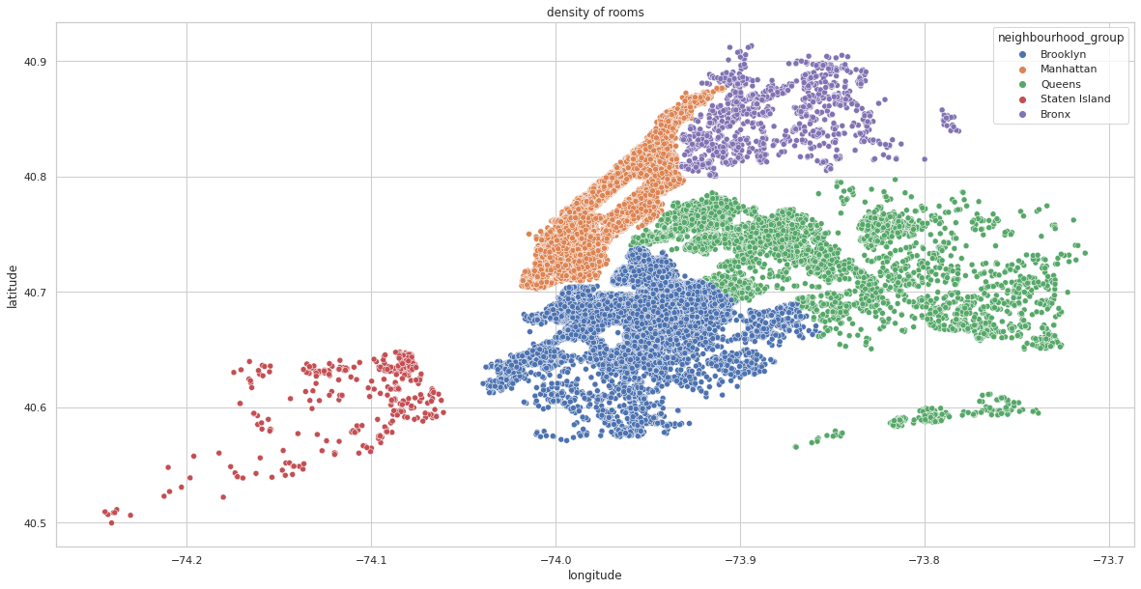
which area got most of the properties
This analysis has been done on the
basis of neighbourhood groups grouping it
with host listings across NYC and plotted a
scatter representation of it using latitude &
longitude.
The scatter plot map shows that Manhattan is
the most preferred area and most of the
investors are interested in Manhattan followed
by Brooklyn ana Queens. Staten island have
least density of properties

Slide 10
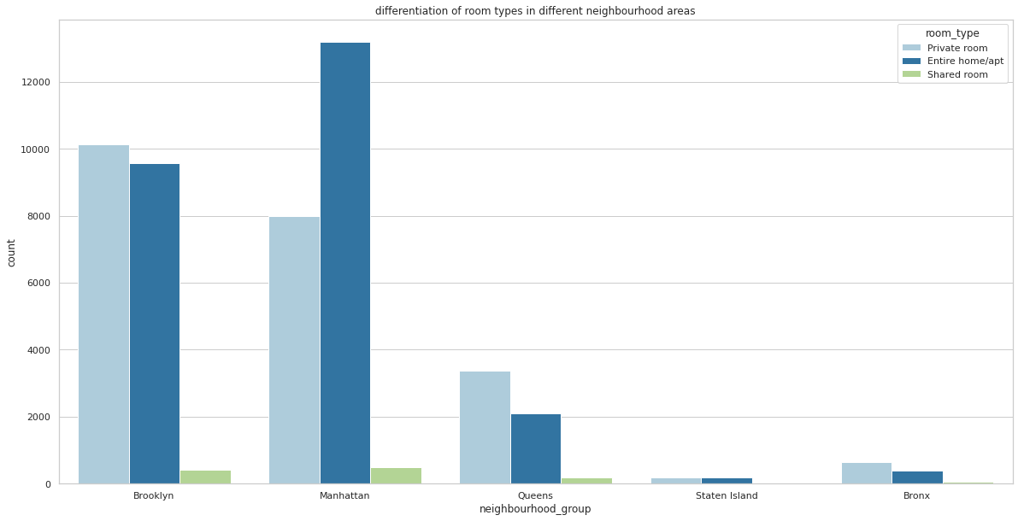
Analysis on room type on the basis of areas
This counterplot shows the relationship between room types with respect to the Neighbourhood_group:
Here we can can conclude that
most of the bookings are from entire
Home/apt followed private room.
Shared rooms have the very least
contribution.
Most of the people preferred entire
Home & private rooms from
manhantten and Brooklyn.

Slide 11
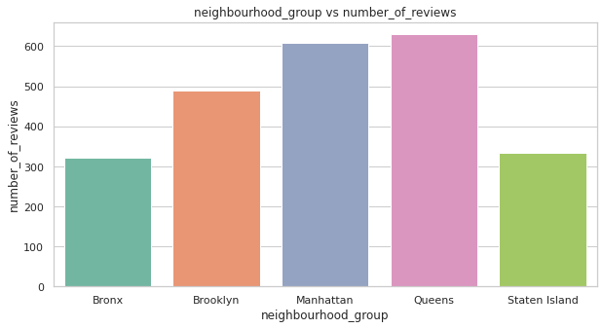
which area got maximum reviews
Analysis on maximum reviews on
the basis of neighbourhood with
the of bar chart:
Queens have the maximum reviews
neighbourhood followed by mahattan.
According to whole data analysis
mahattan have more traffic because
of affordable prices compare to others.

Slide 12
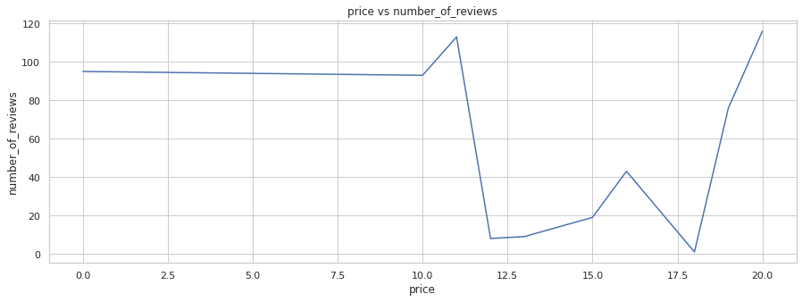
price analysis on the basis of number of reviews
The line graph shows that price
vs number of reviews in
different areas:
From the head 10 listings,
According to different prices reviews
Splits based on their preferences.
Some people prefer low prices &
Medium &high prices according
to their affordability.

Slide 13
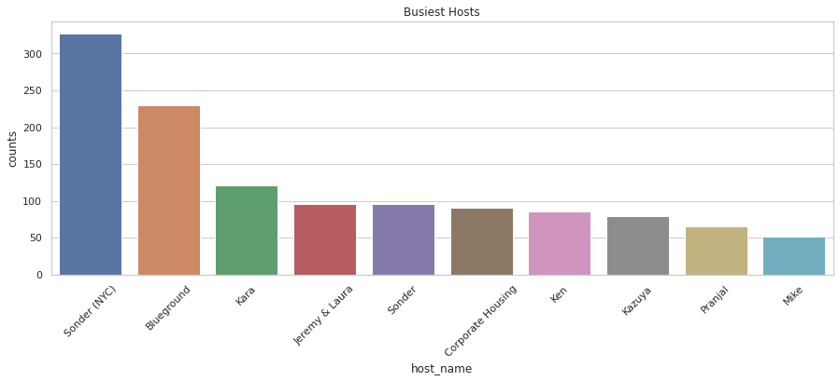
Which hosts are the busiest and why?
The bar chart shows that
top 10 busy hosts. The
Plot shows that sonder
(NYC) has the most busiest
Hosts because they are
from Manhattan
neighbourhood group,
Which is the place, most
People are visited.

Slide 14
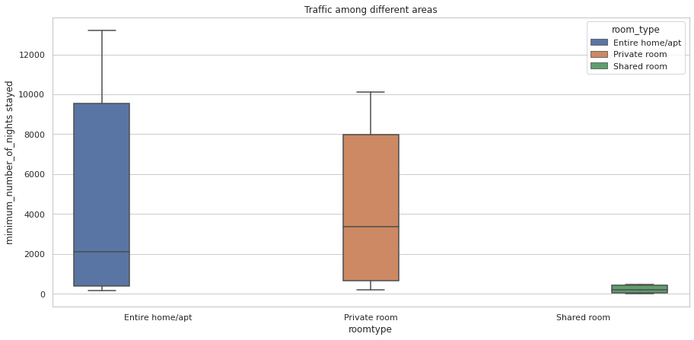
Is there any noticeable difference of traffic among different areas and what could be the reason for it?
Here I can conclude that Manhattan Neighbourhood_group is the most traffic area. Because
they understande the customers and according their preferences
they provide better services. And
they offer affordable prices for
customers. And in Manhattan most
of the people prefer entire
home/apt & private rooms, least
preference on shared rooms.

Slide 15
conclusion
I have done various analysis which directed to the below conclusions:
The scatter plot of neighbourhood groups with property density shows that Manhattan and Brooklyn are the most favorable area for investors as well as customers. So more property owners can be considered for business in this area.
Analysis on room type showed that more people are interested in renting a private room or entire home/apt than shared room making a business concern towards the private room or entire home/apt category.
The queens have maximum reviews on the basis Neighbourhood_group followed by Manhattan.
Price predictions shows that Manhattan is most expensive & Bronx is the cheapest price category.
Finally, Manhattan is the most traffic area of entire home/apt with busiest hosts. So it is better opportunity to increase some entire home/apt in Brooklyn.

Slide 16
Challenges Faced
Reading the dataset and understanding of columns.
Handling NaN values, null values and duplicates.
Designing multiple visualizations to summarize the information in the dataset.
Choosing right plot for the data visualization.
Removing the outliers for some dataset. Finding and sorting the dataset.

Slide 17

BHAVANI LALAM

